Slide 1

GITHUB REPOSITORY
https://github.com/nikhilracha/jobster

Slide 2
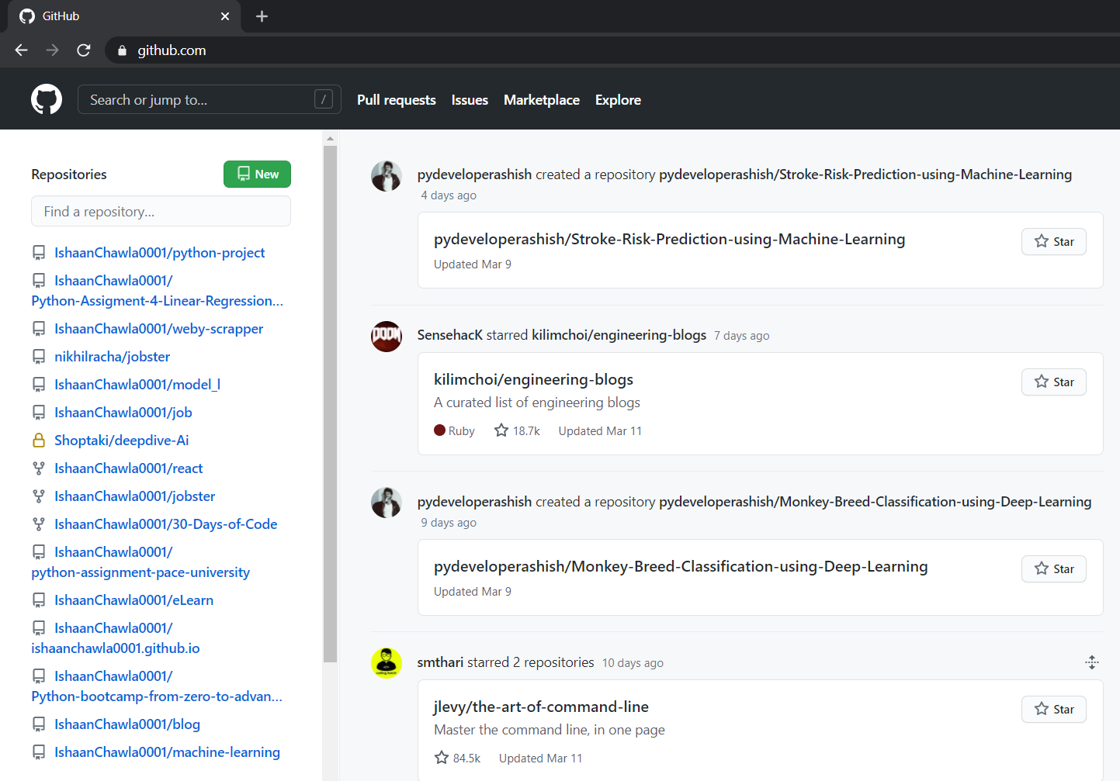
GitHub Login Landing Page

Slide 3
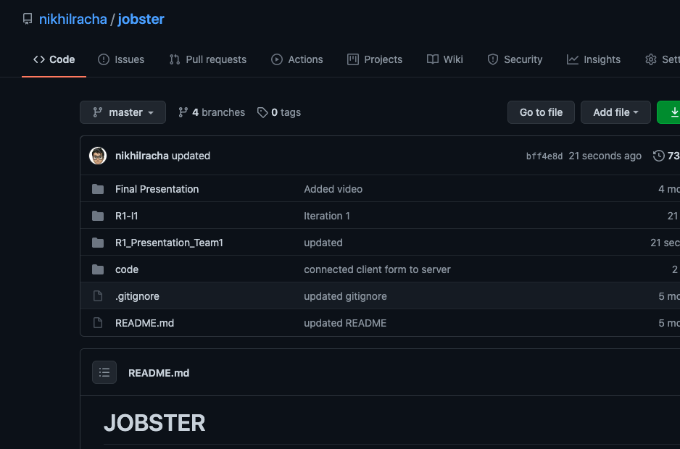
ROOT Folder

Slide 4
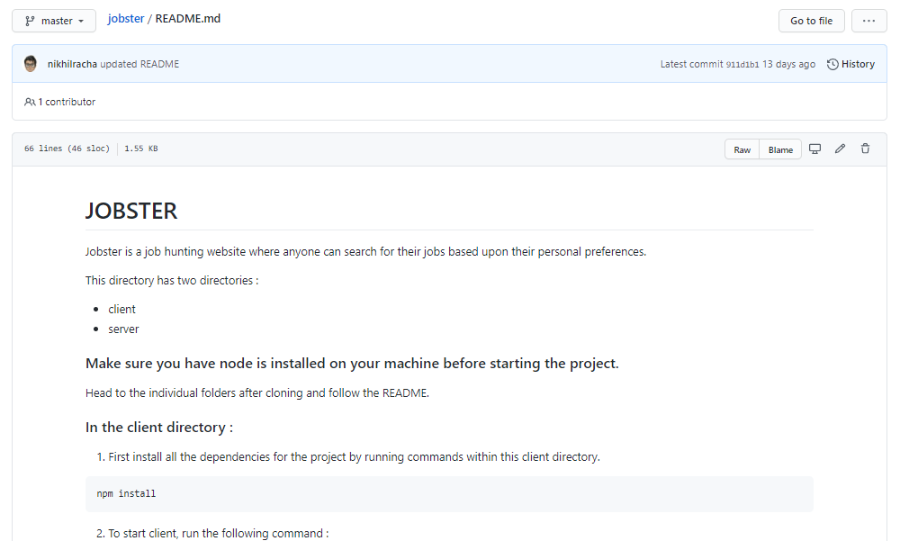
README.md

Slide 5
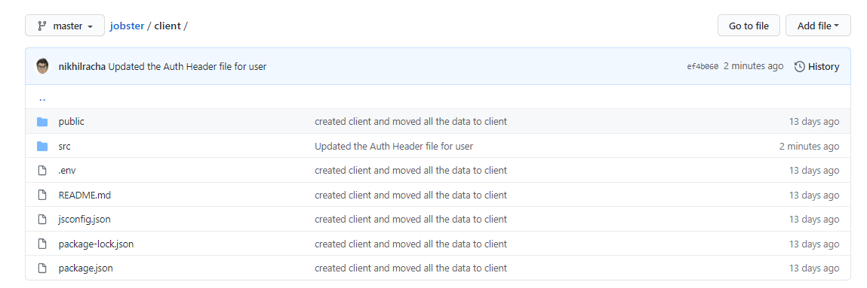
Client Folder

Slide 6
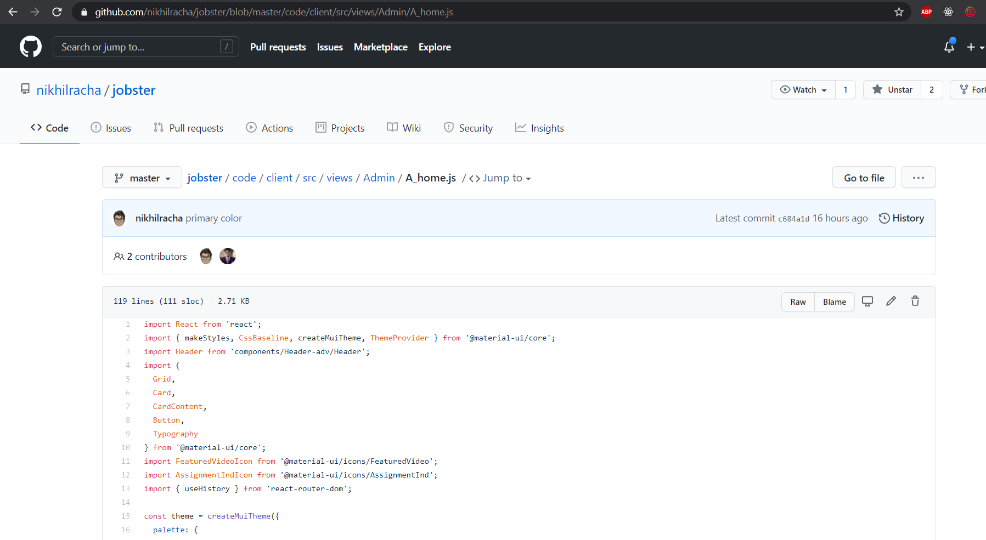
Advertisement Home (a_home.js)

Slide 7
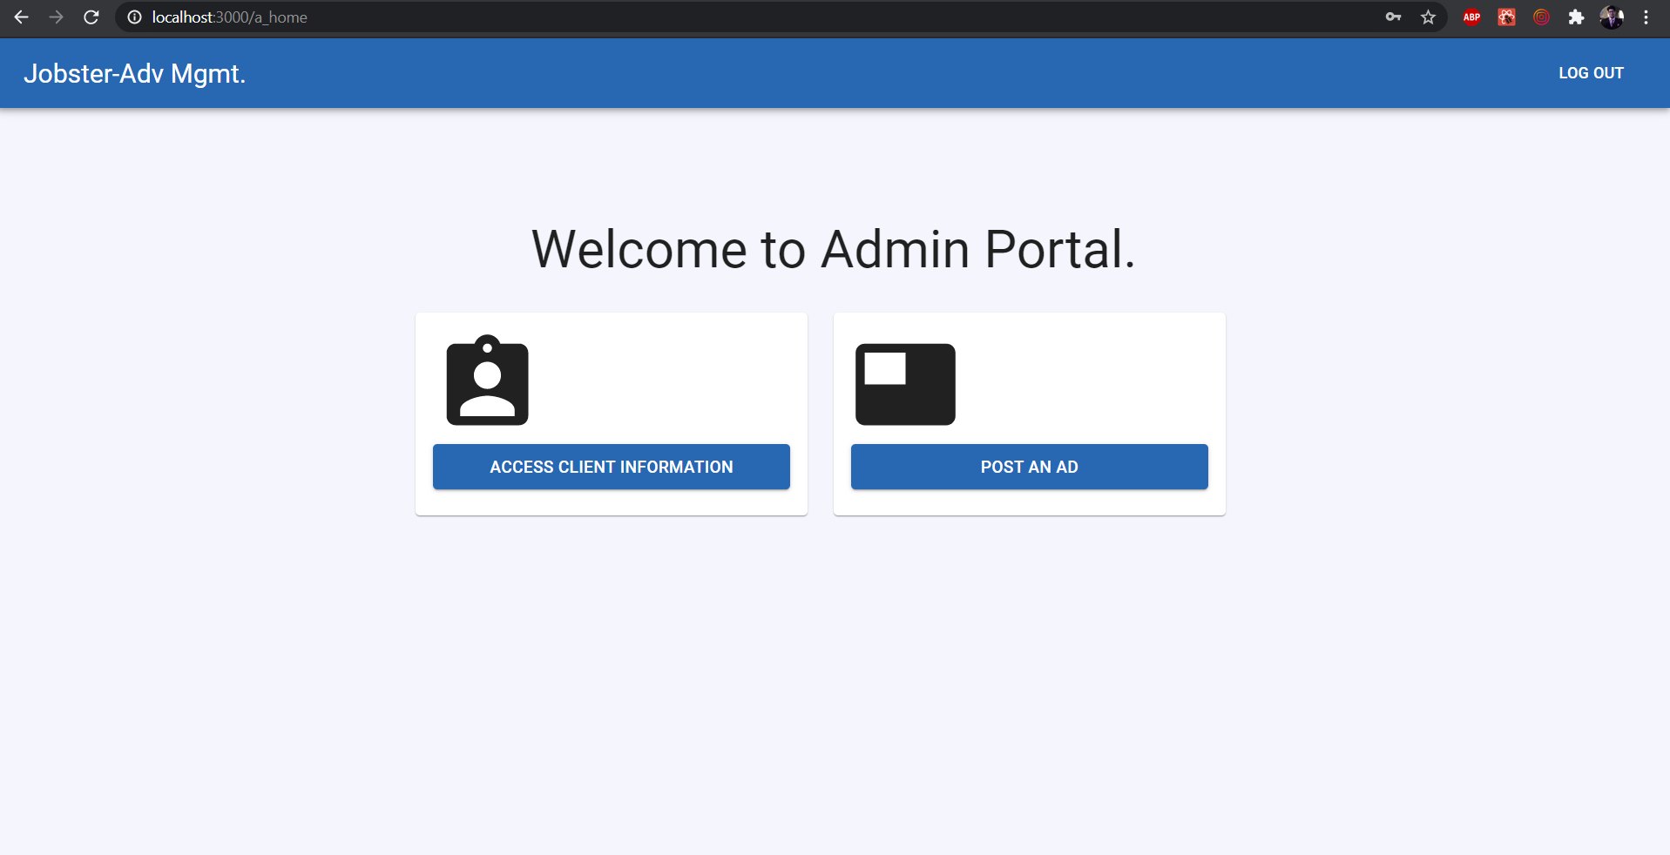
Advertisement Home (a_home.js)

Slide 8
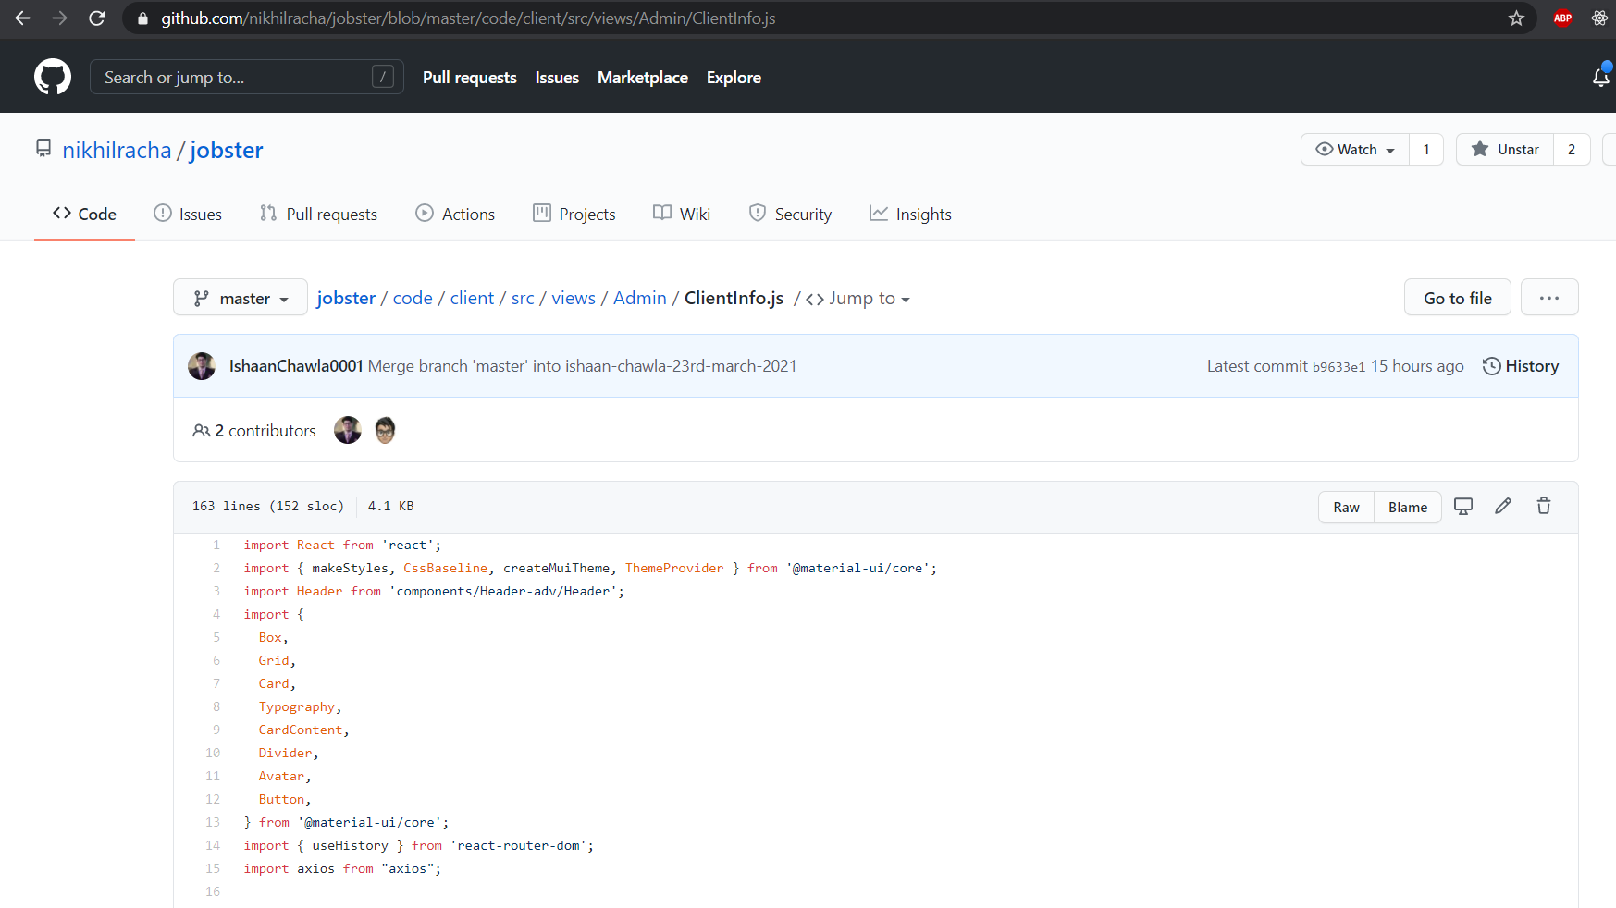
Client Info(CleintInfo.js)

Slide 9
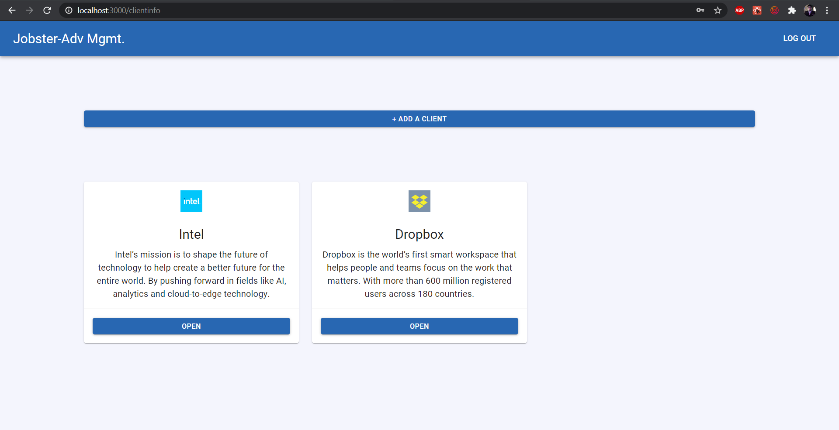
Client Info(CleintInfo.js)

Slide 10
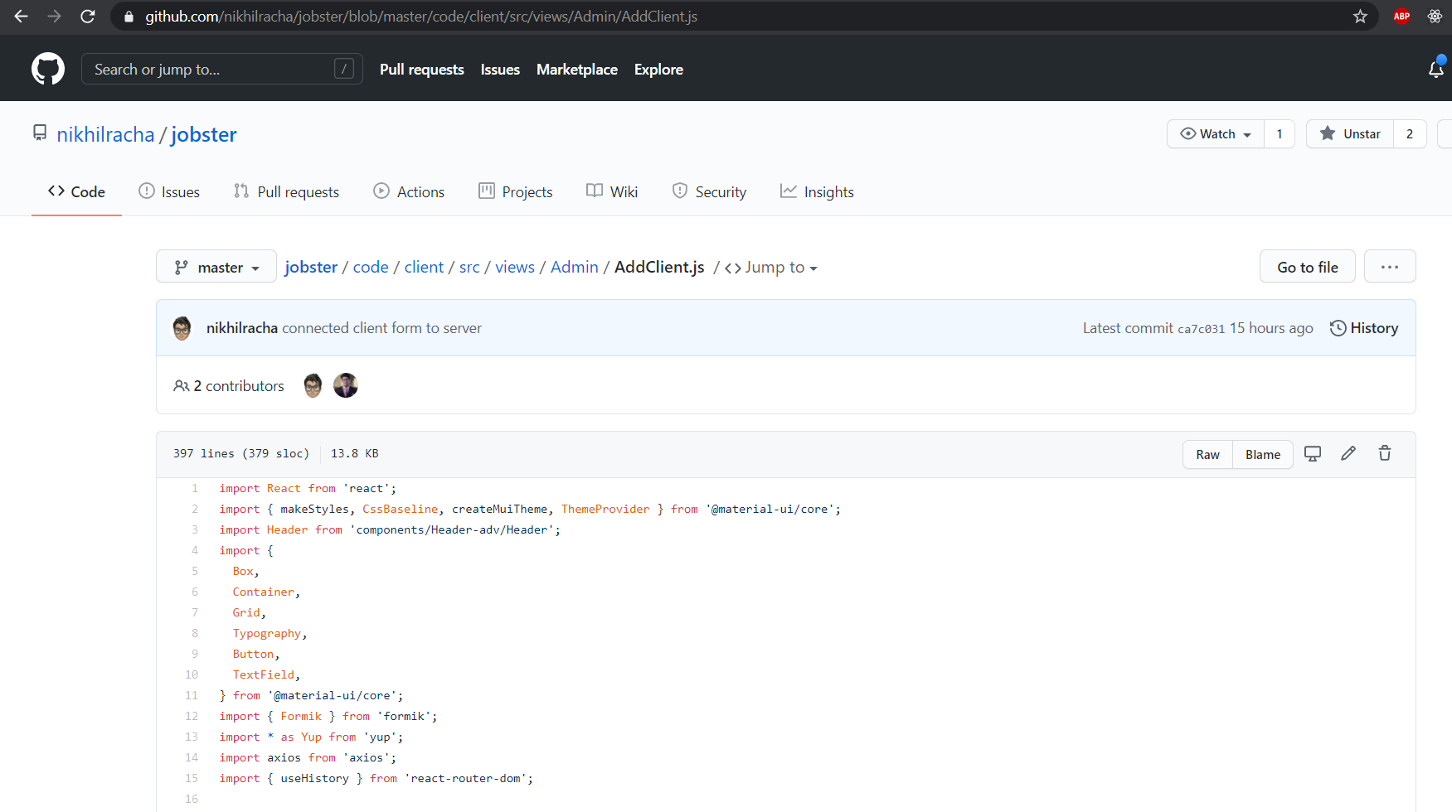
Add Client Form (AddCleint.js)

Slide 11
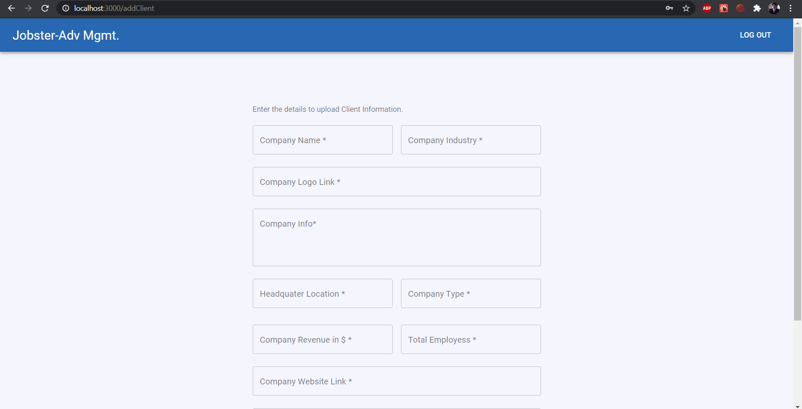
Add Client Form (AddCleint.js)

Slide 12
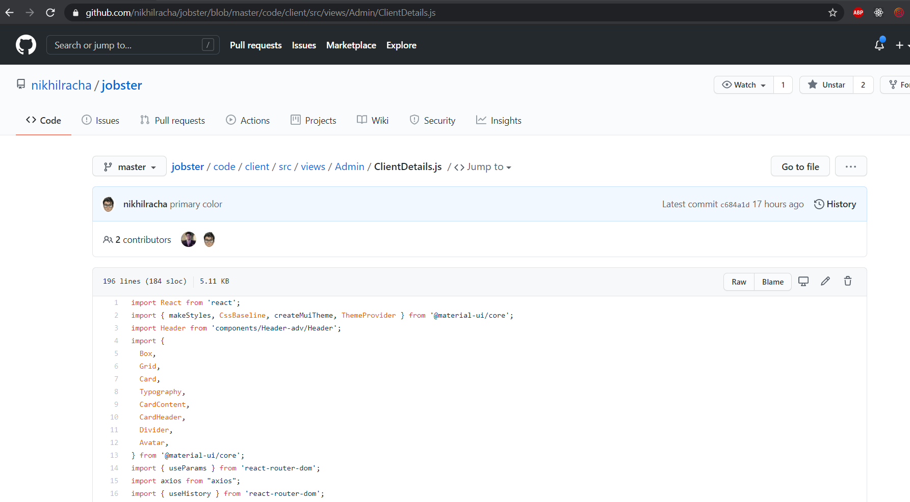
Client Details (ClientDetails.js)

Slide 13
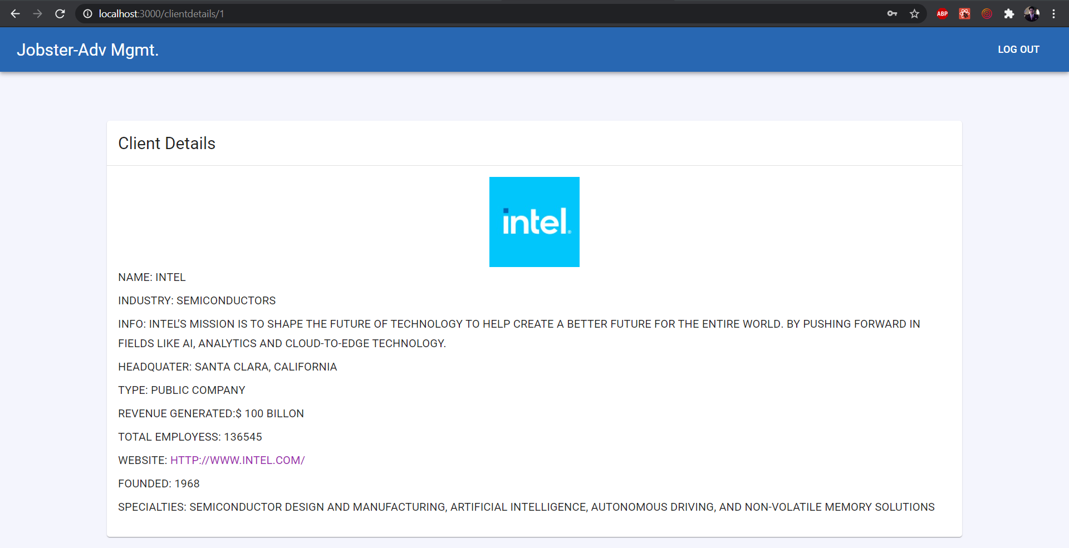
Client Details (ClientDetails.js)

Slide 14
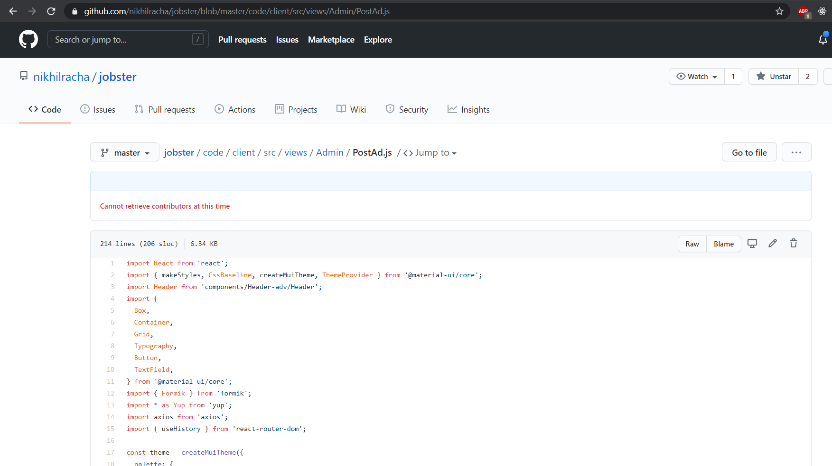
Post Ad (PostAd.js)

Slide 15
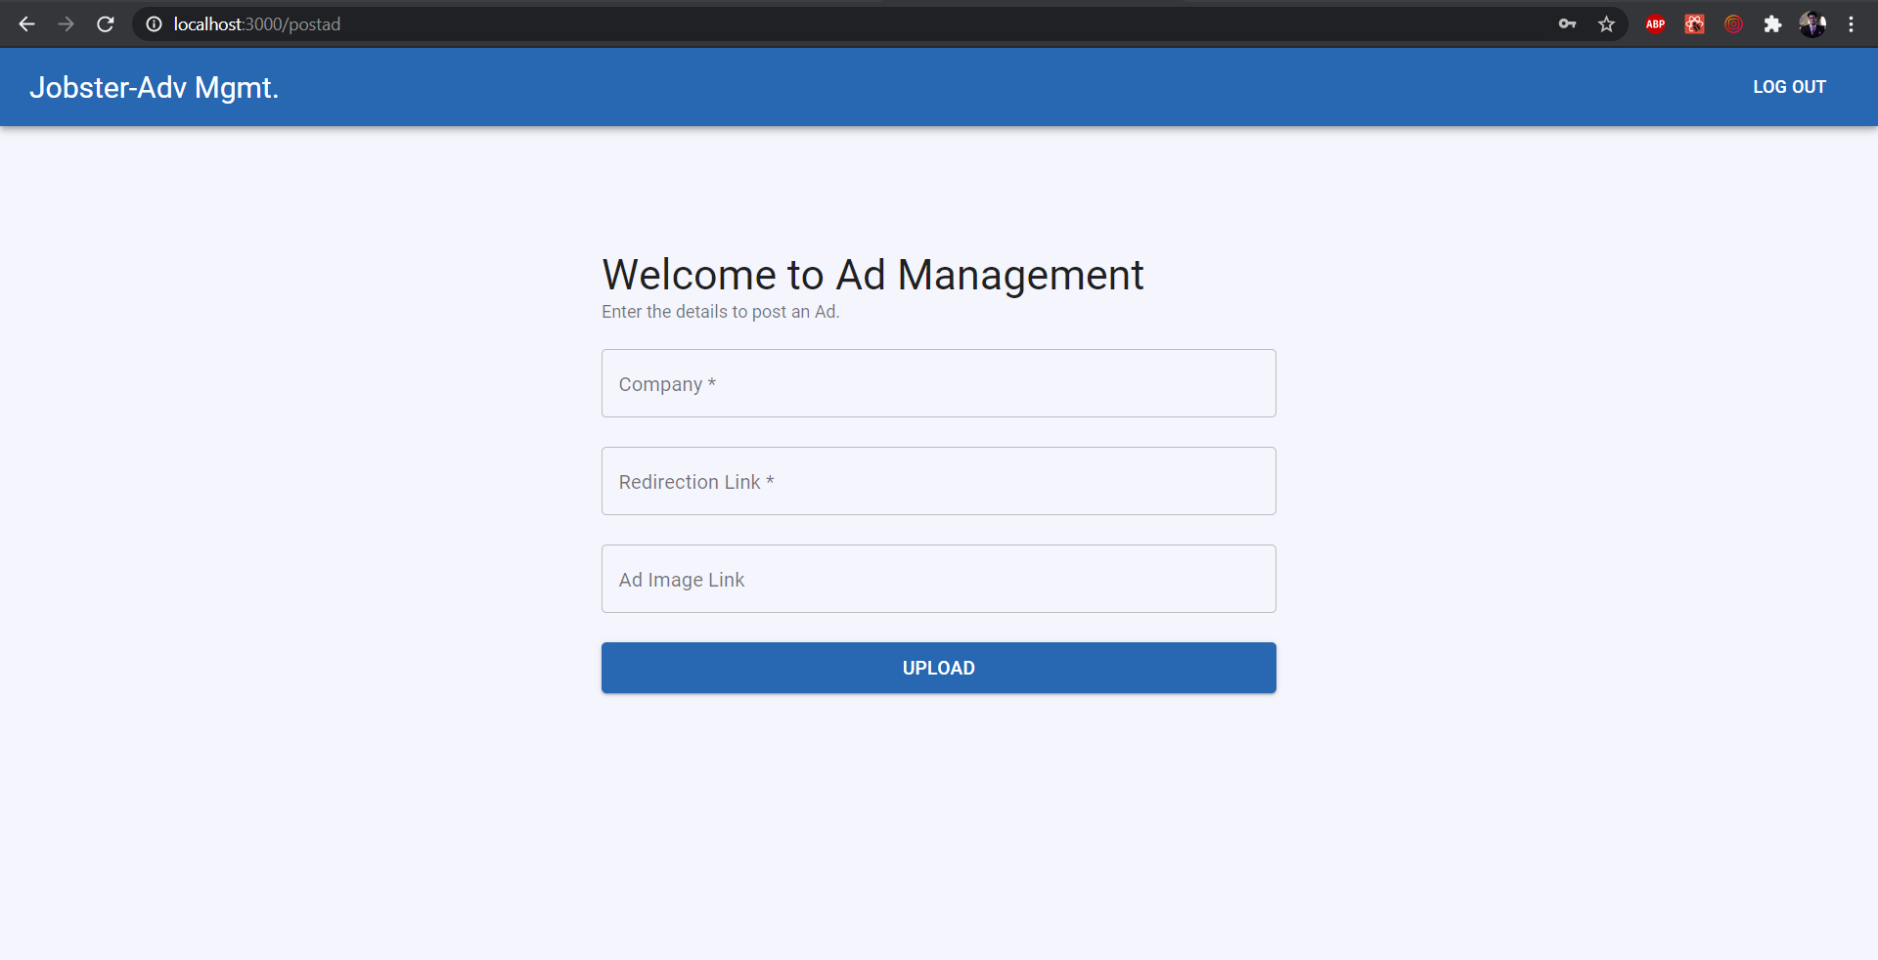
Post Ad (PostAd.js)

Slide 16
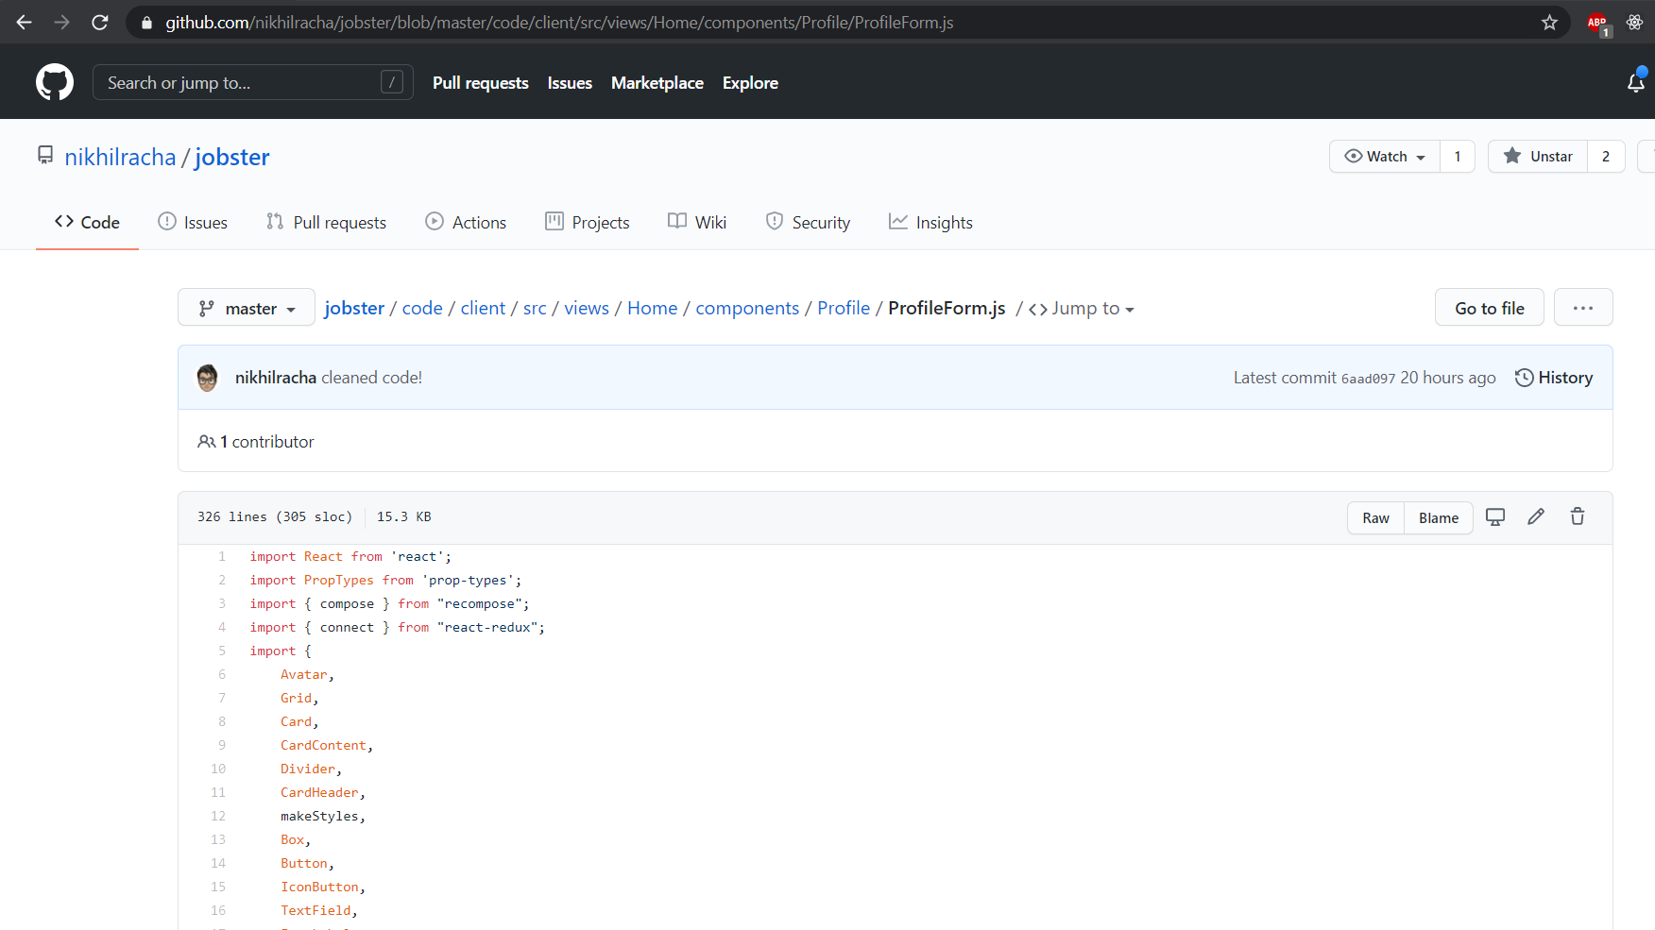
Profile From (ProfileForm.js)

Slide 17
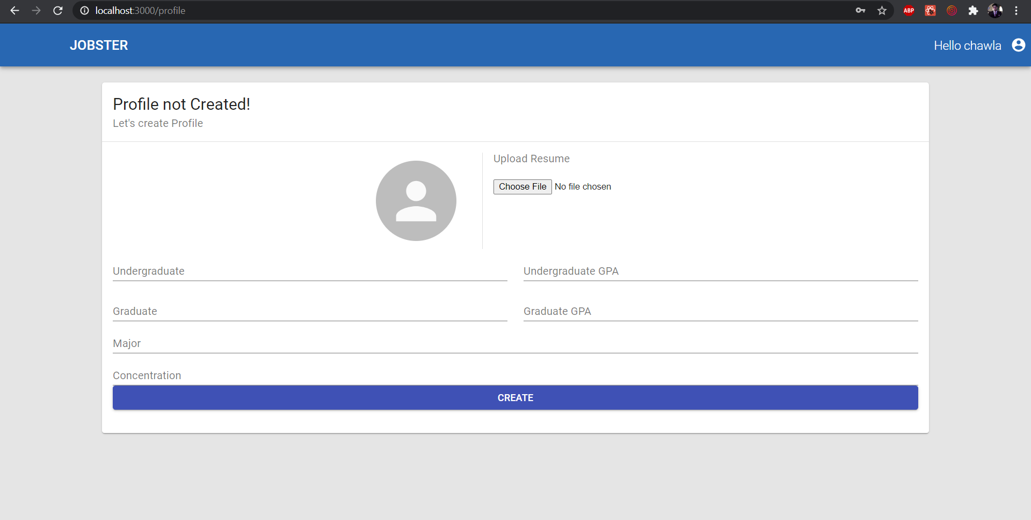
Profile Form (ProfileForm.js)

Slide 18
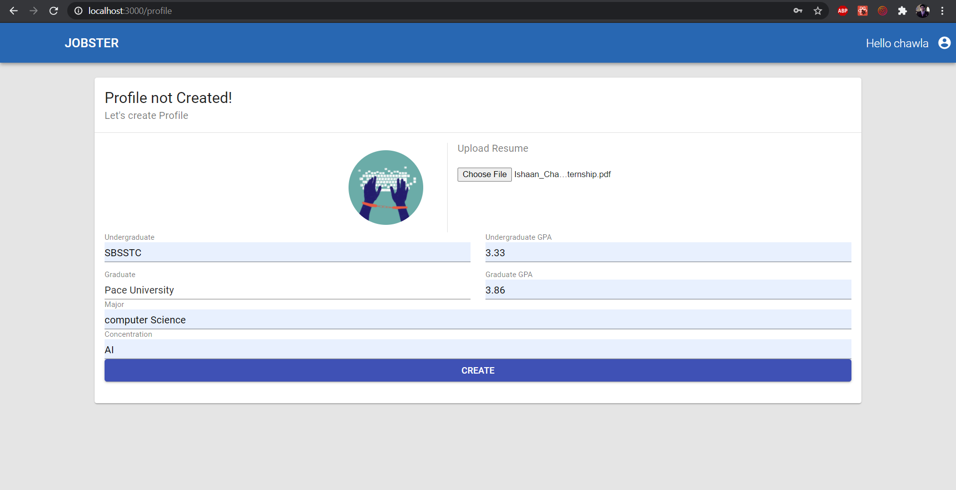
Profile Form (ProfileForm.js)

Slide 19
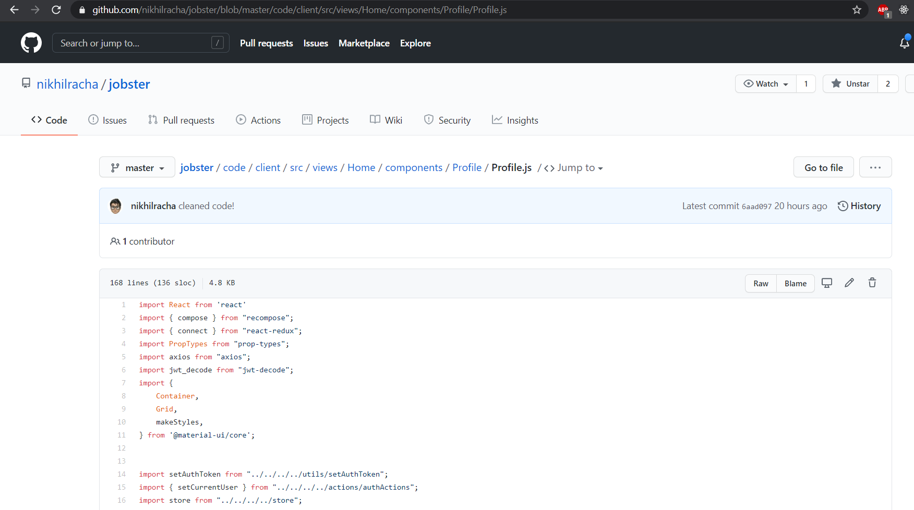
User Profile (Profile.js)

Slide 20
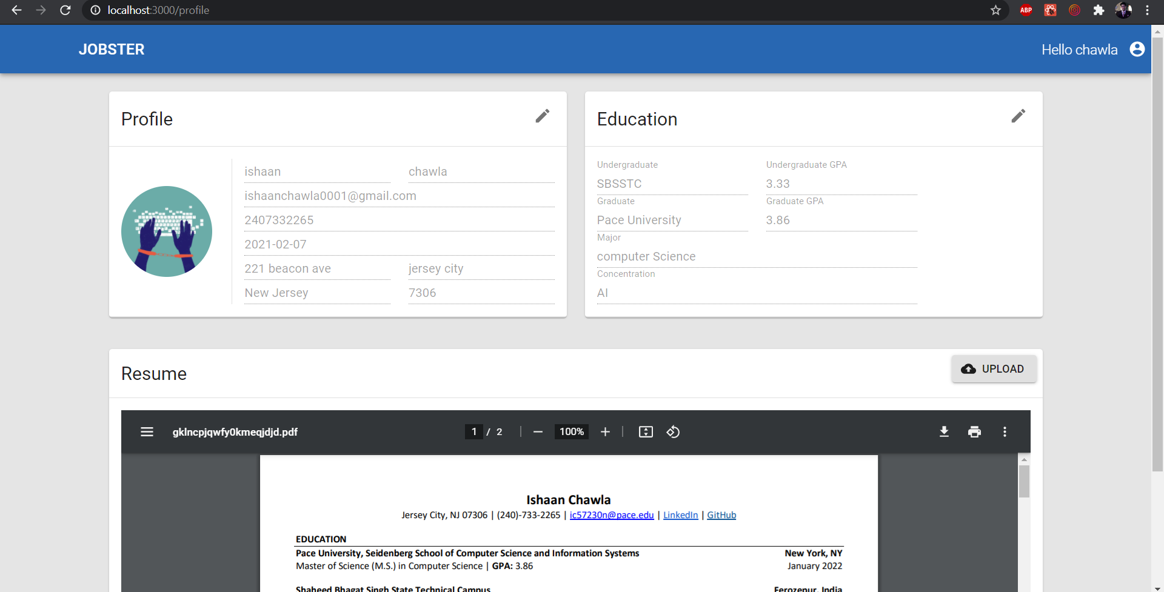
User Profile (Profile.js)

Slide 21
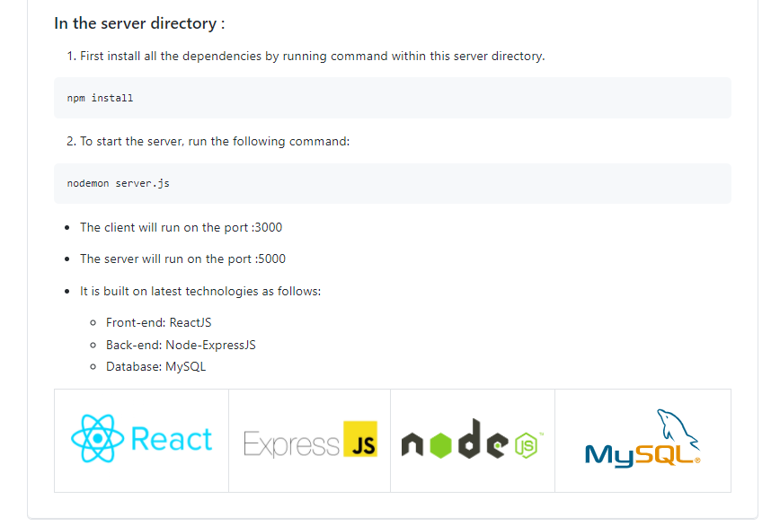
Deployment Process

